Slide 1
Credit Card Price Test Analysis & Recommendations
Stefan Hansel
Risk

Slide 2
Executive Summary
We launched Card with a Price test to gather learnings and enable future optimization
We tested a combination of Annual Fees ($0, $29 $39) and APRs (Prime + 17.74%, Prime + 20.74%)
The aim was to gather learnings about response, funnel conversion, selection & early credit performance
At this point we have sufficient data from Credit Karma to make an initial recommendation
Our champion price point will be $29 AMF & Prime + 20.74% APR
We expect this price point to maximize profitability given the observed performance trade-offs between volume & per Card profitability
This price point also positions us well amongst the different competitors in this space
Future testing / analysis
Continue to monitor performance (losses, attrition, usage) from the Price test
Segmentation analysis based on Bureau profiles & individual pages on Affiliates (e.g. Fair Credit vs. Poor Credit) to understand price sensitivity
Test pricing (including additional price points) on non-affiliate channels (Direct Mail, Organic)
Due to Affiliate channel constraints, we could not offer a clean test (i.e. prospects offered a price range vs. a specific price point)

Slide 3
Card Price Test overview
Five strategies: 3 with Annual Fees, 2 without; 3 on low APR, 2 on higher APR
Analysis performed on Credit Karma issuance (~4.5k Cards issued in Q1 ‘18)
Pricing Strategy | 0001 | 0002 | 2001 | 2002 | 3001
Annual Fee | $0 | $0 | $29 | $29 | $39
APR (Spread over Prime) | 17.74% | 20.74% | 17.74% | 20.74% | 17.74%
Resulting APR as of March 20th 2018 | 22.24% | 25.24% | 22.24% | 25.24% | 22.24%
Share of Test Applications | 15.0% | 15.0% | 23.3% | 23.3% | 23.3%
Test Aims:
Gather learnings about response, funnel conversion, selection & early credit performance by pricing
Understand sensitivity to Annual Fee vs. APR
Enable future population segmentation & product offerings based on sensitivity to Pricing
Notes:
Expectation , no fee product converts 50% more, not seen;
Voiceover, no true test as we display a range of pricing. Until preapproval available not much we can hope to improve with affiliates

Slide 4
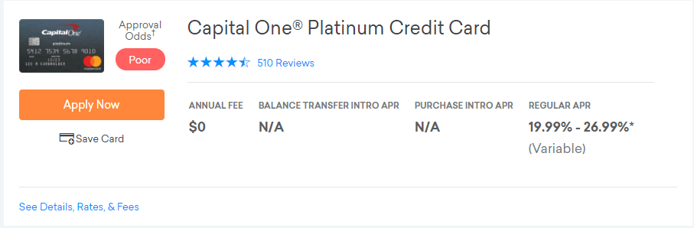
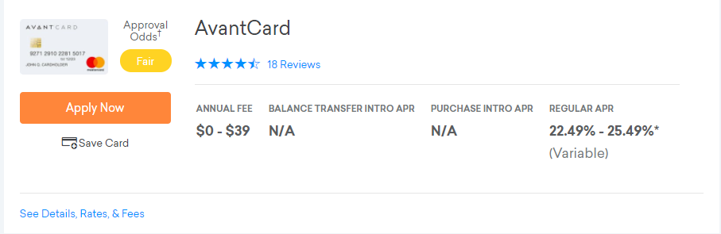
We face constraints in executing a clean test on Affiliates
We could not execute a clean No Annual Fee offer on Credit Karma for this test; affects top of funnel response & selection – we have reads for the rest of the funnel
Notes:
Expectation , no fee product converts 50% more, not seen;
Voiceover, no true test as we display a range of pricing. Until preapproval available not much we can hope to improve with affiliates

Slide 5
Test Learnings to Date – Minimal APR sensitivity, some sensitivity to Annual Fees
No Annual Fee: ~5% conversion decline with higher APR
$29 Annual Fee: ~1% conversion decline with higher APR
$39 Annual Fee
22.24% APR with $0, $29, $39 AMFs:
~15% decline in conversion between $0 & $29 Annual Fee
~3% decline between $29 & $39 Annual Fee

Slide 6
Test Learnings to Date – No selection impact observed
Pricing Strategy | 0001 | 0002 | 2001 | 2002 | 3001
Strategy shown (count customers) | 3,392 | 3,211 | 5,283 | 5,084 | 5,116
Issued cards | 793 | 717 | 1,082 | 1,026 | 1,011
Conversion end-to-end | 23.4% | 22.3% | 20.5% | 20.2% | 19.8%
Average Application FICO | 607 | 608 | 606 | 607 | 608
Average Application Model Score | 0.219 | 0.220 | 0.221 | 0.221 | 0.220
Average Application Vantage 3 score | 584 | 585 | 585 | 584 | 585
Average Issued FICO | 638 | 640 | 638 | 637 | 640
Average Issued Model Score | 0.084 | 0.082 | 0.082 | 0.082 | 0.081
Average Issued Vantage 3 Score | 617 | 618 | 620 | 618 | 618
Average Issued Line | $579 | $599 | $595 | $590 | $598
Offers randomized across Applicants
Minimal selection effects observed with Issued customers
Notes:
Technical notes: Randomization appears to work, distributions of model score, FICO and Vantage do not show substantial difference between the strategies, leaving out emerging segment as count is very low

Slide 7
Pricing recommendation made to maximize profits (given data we have to date)
Profitability across pricing strategies is a trade-off between Volume (# Cards) & Profitability/Card
Profitability Component | Assumption used across Pricing Strategies | Comments
Volumes | Credit Karma conversion data
Per Card Profitability
Acquisition Costs
CPA | Same
Reporting costs | Same | ($1-$2) difference expected by pricing strategy
Revenue
Annual Fee | As per Pricing strategy | Given similar credit profiles & Credit Lines, Utilization, Collectability etc. are assumed to be the same
Finance Charges | As per Pricing strategy
Late Fees & Interchange | Same
Attrition | Same | Will be higher for Annual Fee strategies
Costs
Credit Losses | Same | Given similar profiles & Credit Lines, delinquency & loss metrics are assumed to be the same
Ops Costs | Same
Cost of Funds | Same

Slide 8
Profitability comparison by Pricing strategy
Limited data available other than for funnel metrics
Simplified annualized view of profitability used for recommendation vs. full UE
Strategy | 0001 | 0002 | 2001 | 2002 | 3001
Funnel conversion | 23.40% | 22.30% | 20.50% | 20.20% | 19.80%
Relative Conversion | 1.00 | 0.95 | 0.87 | 0.86 | 0.85
APR | 22.24% | 25.24% | 22.24% | 25.24% | 22.24%
Funding Costs | 7.24% | 7.24% | 7.24% | 7.24% | 7.24%
(Net Interest Margin) NIM | 15.00% | 18.00% | 15.00% | 18.00% | 15.00%
Annual Fee | $0 | $0 | $29.00 | $29.00 | $39.00
Avg. Balance (UE) | $398 | $398 | $398 | $398 | $398
Effective Annual Fee Margin | 0.00% | 0.00% | 7.29% | 7.29% | 9.80%
Proxy Annualized Revenue | $59.70 | $71.64 | $88.70 | $100.64 | $98.70
x Conversion | $59.70 | $68.27 | $77.71 | $86.88 | $83.52
Notes:
2002 preferable, average balance taken from UE expectation for months 6-12

Slide 9

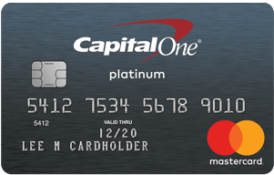
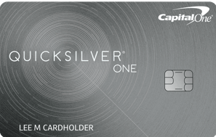

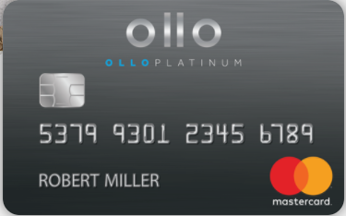
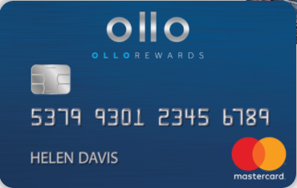

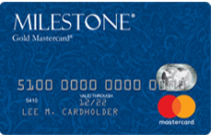


Competitive positioning for proposed champion pricing
Issuer | Annual Fee | APR
Avant | $29 | 25.24%
Capital One Quicksilver One | $39 | 24.99%-28.99%
Capital One Platinum | $0 | 19.99%-26.99%
Ollo | $0 | 24.99%
Ollo Rewards | $39 | 24.99%
Deserve Edu | $0 | 19.99%
LendUp Arrow | $59 | 29.99%
Credit One | $0-$99 | 19.15%-25.24%
Milestone/Indigo (Genesis) | $35-$99 | 23.90%

Slide 10
Sensitivity Analysis – Annual Fee / APR trade-offs
The $39 Annual Fee, 22.24% APR pricing wins if we have low usage
$0 Annual Fee, 29.99% APR pricing wins if we have higher usage and/or limited decline in conversion
$270
$29 Annual Fee, 25.24% APR
$29 Annual Fee, 25.24% APR
$380
$720
$39 Annual Fee, 22.24% APR
$0 Annual Fee, 29.99% APR with different conversion rates
Notes:
Voiceover, serious risk in less conversions due to positioning in market above all else.
May be good for future testing
For higher adb’s higher interest always wins, in the long run higher apr more profitable, however, for the next two years we do not balance high enough to push it over the edge, think prudent to analyze at later point.

Slide 11
Next steps
Continue to monitor performance by strategy
FPDs by mid-May
Longer performance (several cycles, longer DPDs) prior to scaling in end of quarter
Investigate options for optimization of pricing by risk profile and/or Affiliate positioning (Fair Credit vs. Poor Credit) in case any such correlations exist
Additional testing
Direct Mail, Organic
Additional price points - $0 Annual Fee, 29.99% APR

Slide 12
Legal & Compliance
Compliance and Legal reviewed the proposal and met with members of the Credit Card team to discuss design and implementation of the credit policy change. Compliance and Legal have not identified any increase in regulatory or legal risk with this change.

